Slide 1

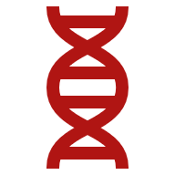
Detection of Thyroid Nodules using Deep Learning

Slide 2
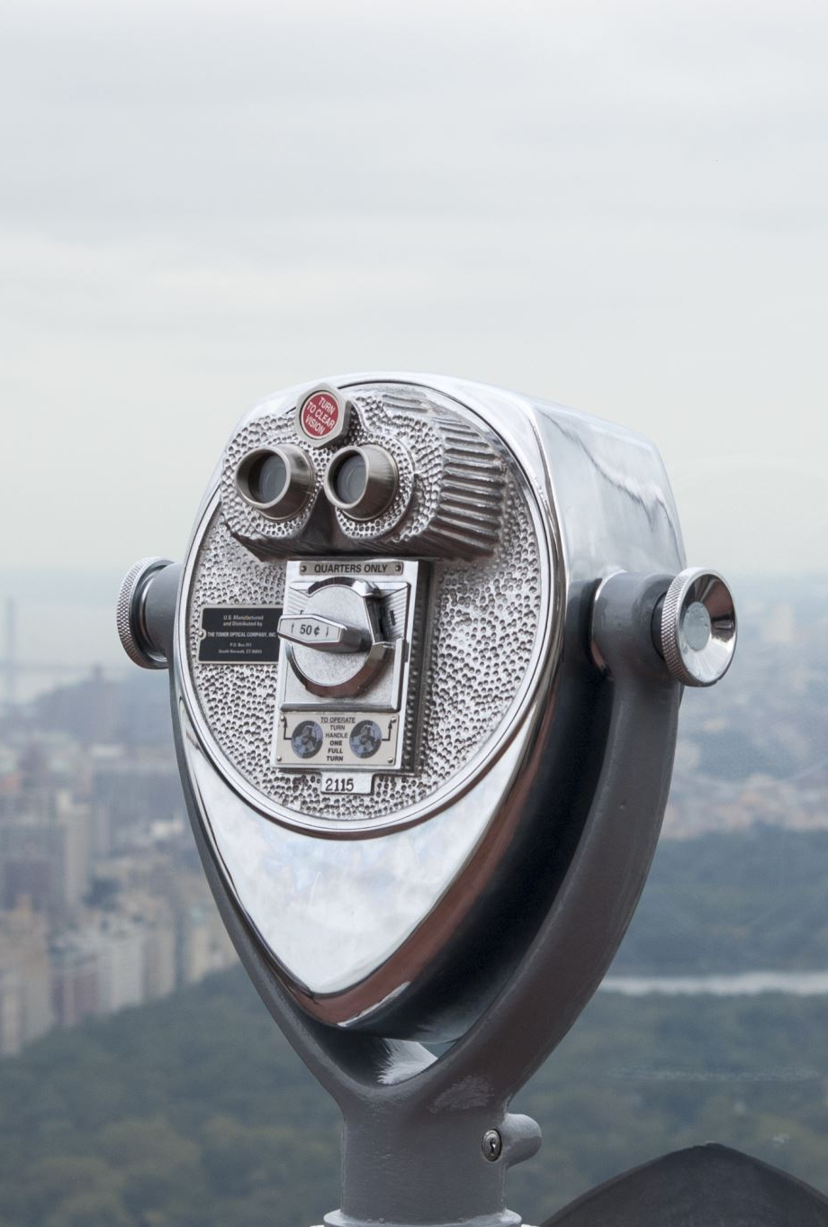
Overview
Introduction
Aim & Objective
Problem Statement
Subject Area
Project Goals
Related Studies
Research Gaps
Datasets
Methodology
Model Architecture & Evaluation
Results
Conclusion
References

Slide 3
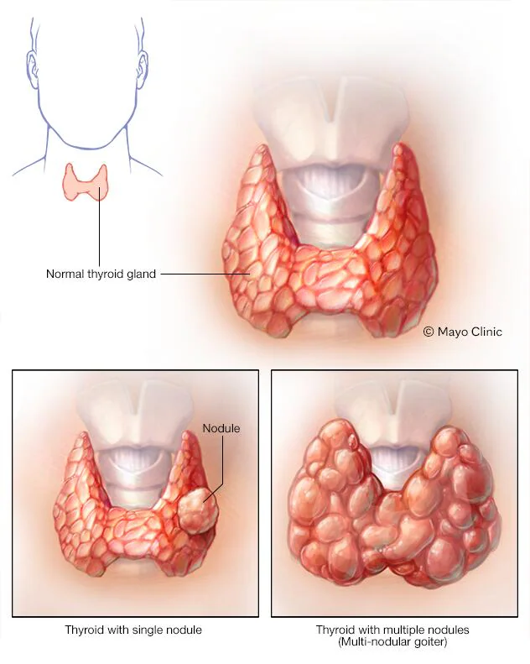
What are Thyroid Nodules?
Thyroid nodules are nodules (raised areas of tissue or fluid) which commonly arise within an otherwise normal thyroid gland.[1] They may be hyperplastic or tumorous, but only a small percentage of thyroid tumors are malignant. Small, asymptomatic nodules are common, and often go unnoticed (Thyroid Nodule, 2023).

Slide 4
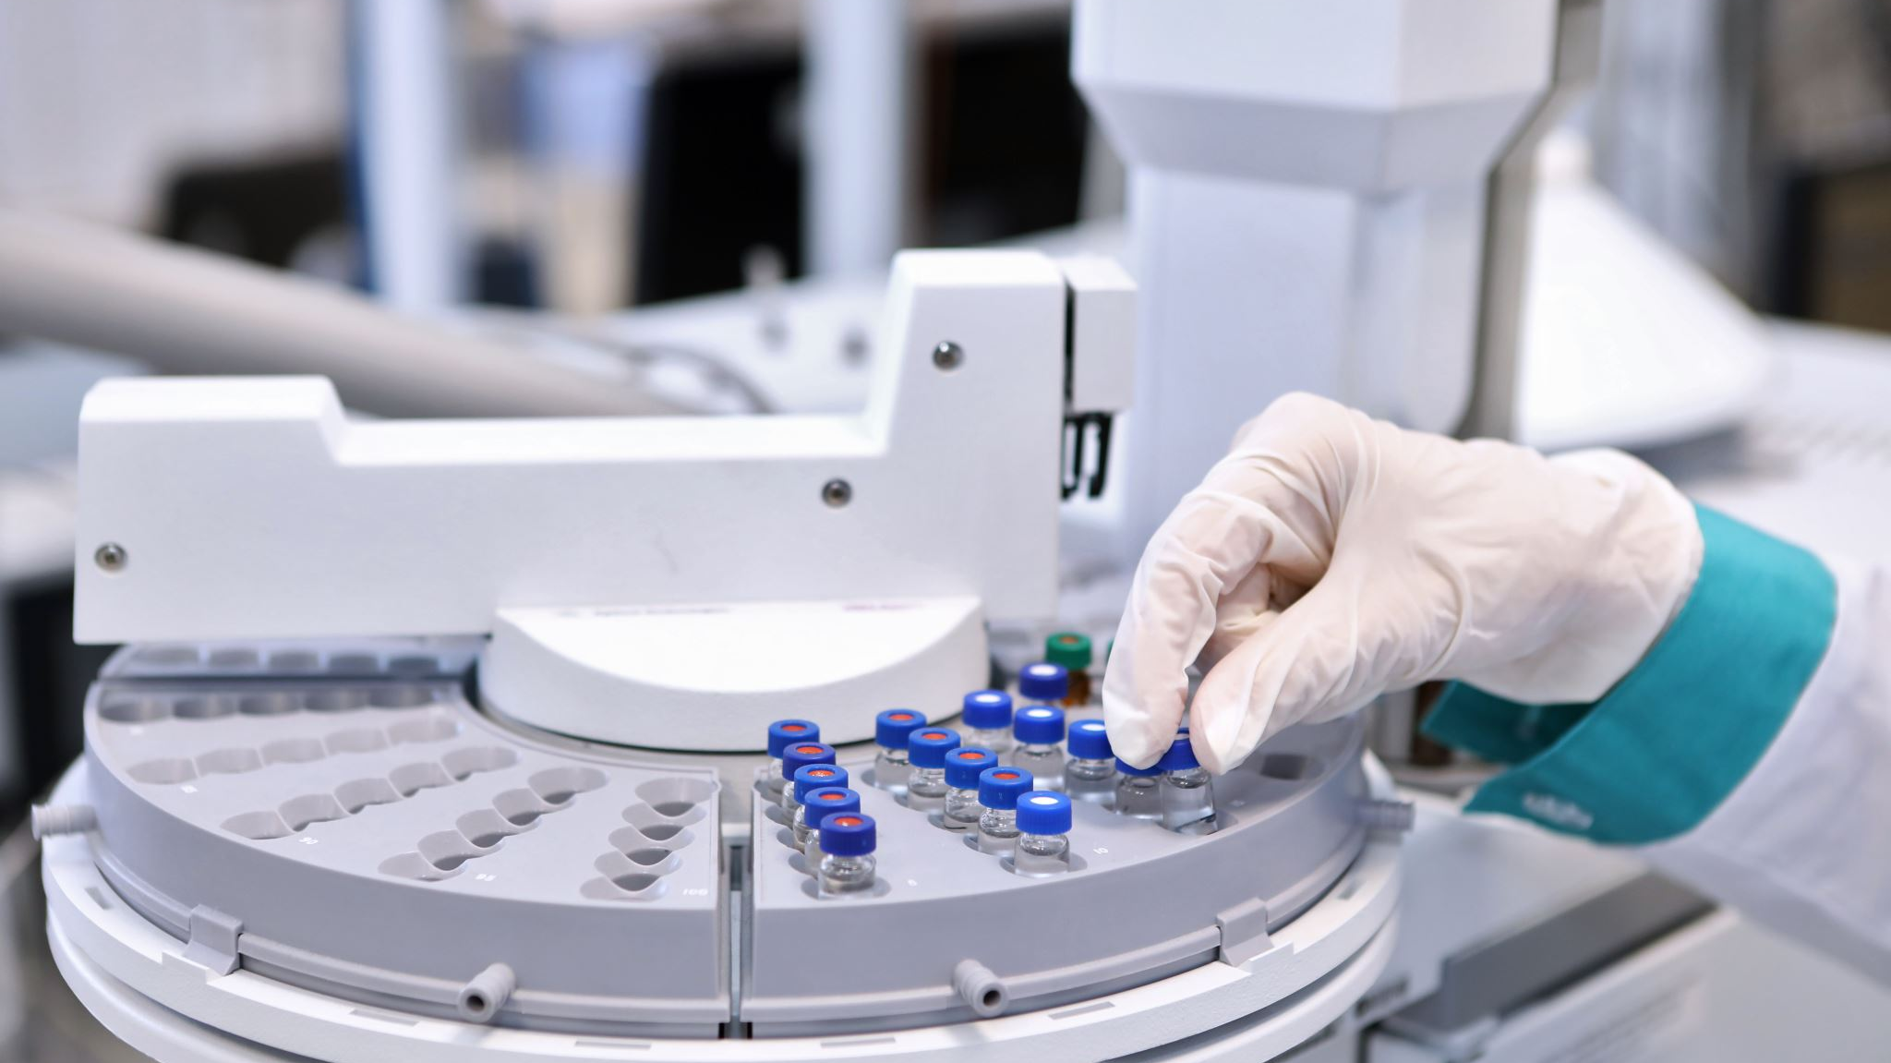




Introduction
Thyroid nodules are common and require accurate classification to discern malignancy. Deep learning offers a promising solution by analyzing ultrasound images.
They are typically diagnosed through a combination of physical examination, blood tests, and imaging tests such as ultrasound, CT scan, or MRI. Fine-needle aspiration biopsy may be performed to determine if a nodule is benign or malignant. Accurate detection and characterization of thyroid nodules is crucial for identifying potential thyroid cancer and guiding appropriate treatment.

Slide 5
Aim and objective
This project aims to utilise Recurrent Neural Networks (RNNs) for the analysis of a dataset consisting data of different patients of thyroid nodules.
The objective of training the RNN model on this dataset is to improve patient care and advance medical diagnostics by precisely identifying and categorising thyroid nodules.

Slide 6
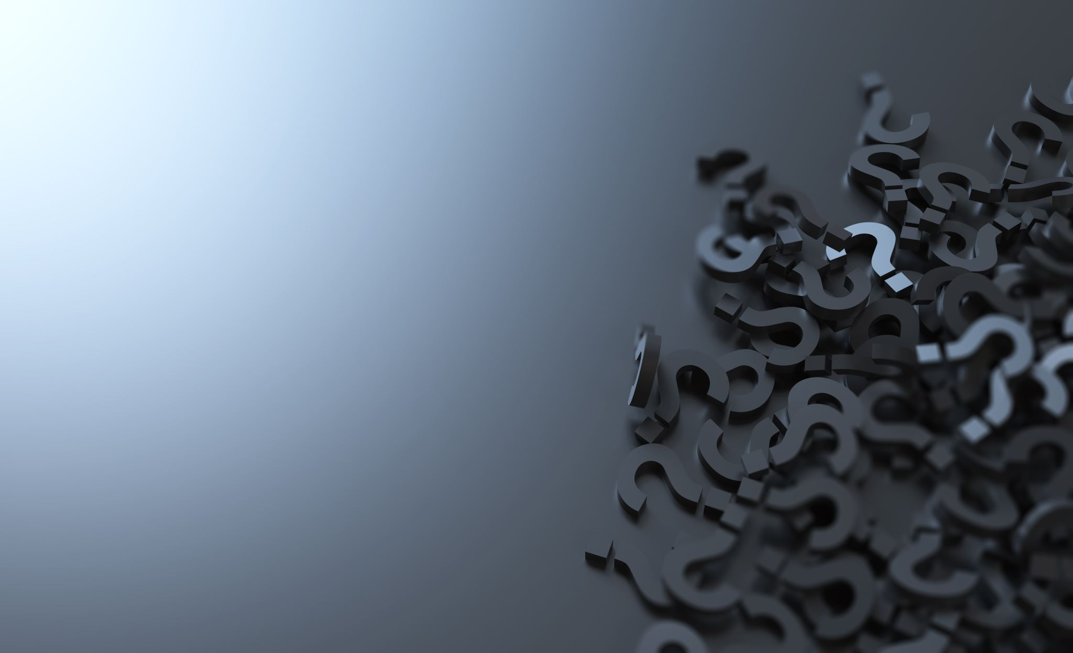
Problem Statements:
After reviewing the provided dataset on hypothyroidism, several problem statements can be identified for further analysis and research:
Limited availability of labeled data for training robust RNN models.
Challenges in capturing temporal dynamics and longitudinal analysis with RNN architectures.
Integration of RNN-based systems into clinical workflows and existing healthcare infrastructure.

Slide 7
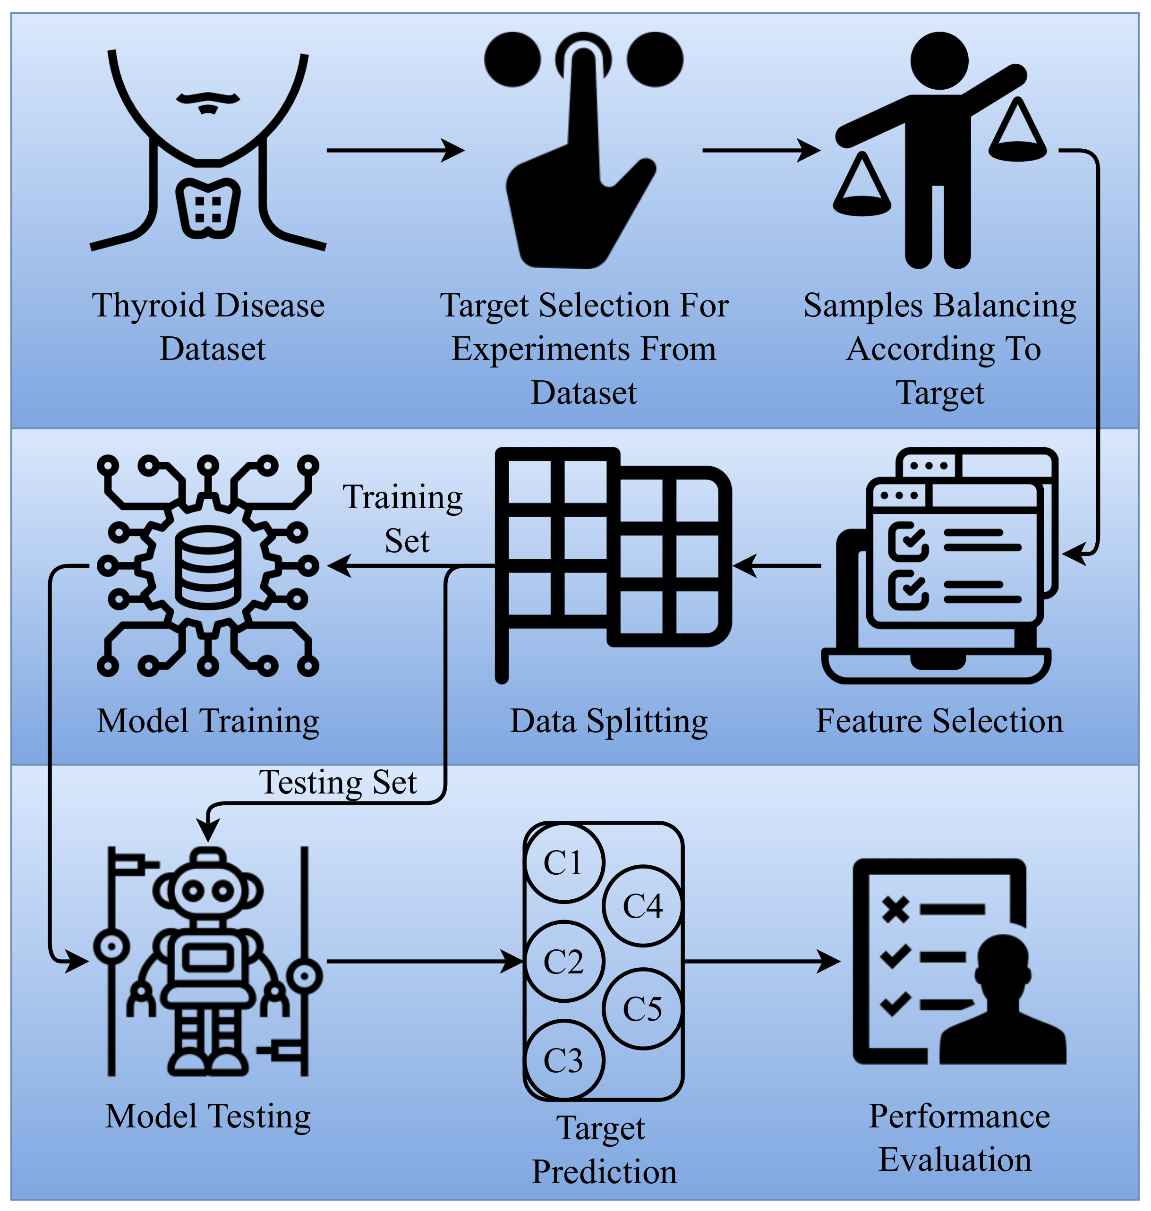
Subject Area
Broadly this project comes under the discipline of Medical Imaging and deep learning.
The integration of deep learning with medical imaging enables the development of more accurate and efficient methods for thyroid detection, aiding in early diagnosis and treatment planning.

Slide 8

Project Goals
The primary goal of this project is to leverage RNNs to develop a robust model for the detection and classification of thyroid nodules based on medical imaging data, particularly ultrasound images.
Additionally, the project aims to explore the efficacy of RNNs compared to other deep learning architectures and traditional machine learning methods.
Secondary goals include evaluating model performance, optimizing hyperparameters, and creating a user-friendly interface for clinical integration.

Slide 9
Related Studies:
Automatic Detection of Thyroid Nodule Characteristics From 2D Ultrasound Images (Han et al., 2023).
Automatic thyroid nodule recognition and diagnosis in ultrasound imaging with the YOLOv2 neural network (Wang et al., 2019).
Computer-aided diagnosis system of thyroid nodules Ultrasonography (Li et al., 2020).

Slide 10
Research Gaps
Methodology and Model Architecture
Dataset Variability
Evaluation Metrics
Clinical Validation and Real-world Application
Ethical and Regulatory Considerations

Slide 11
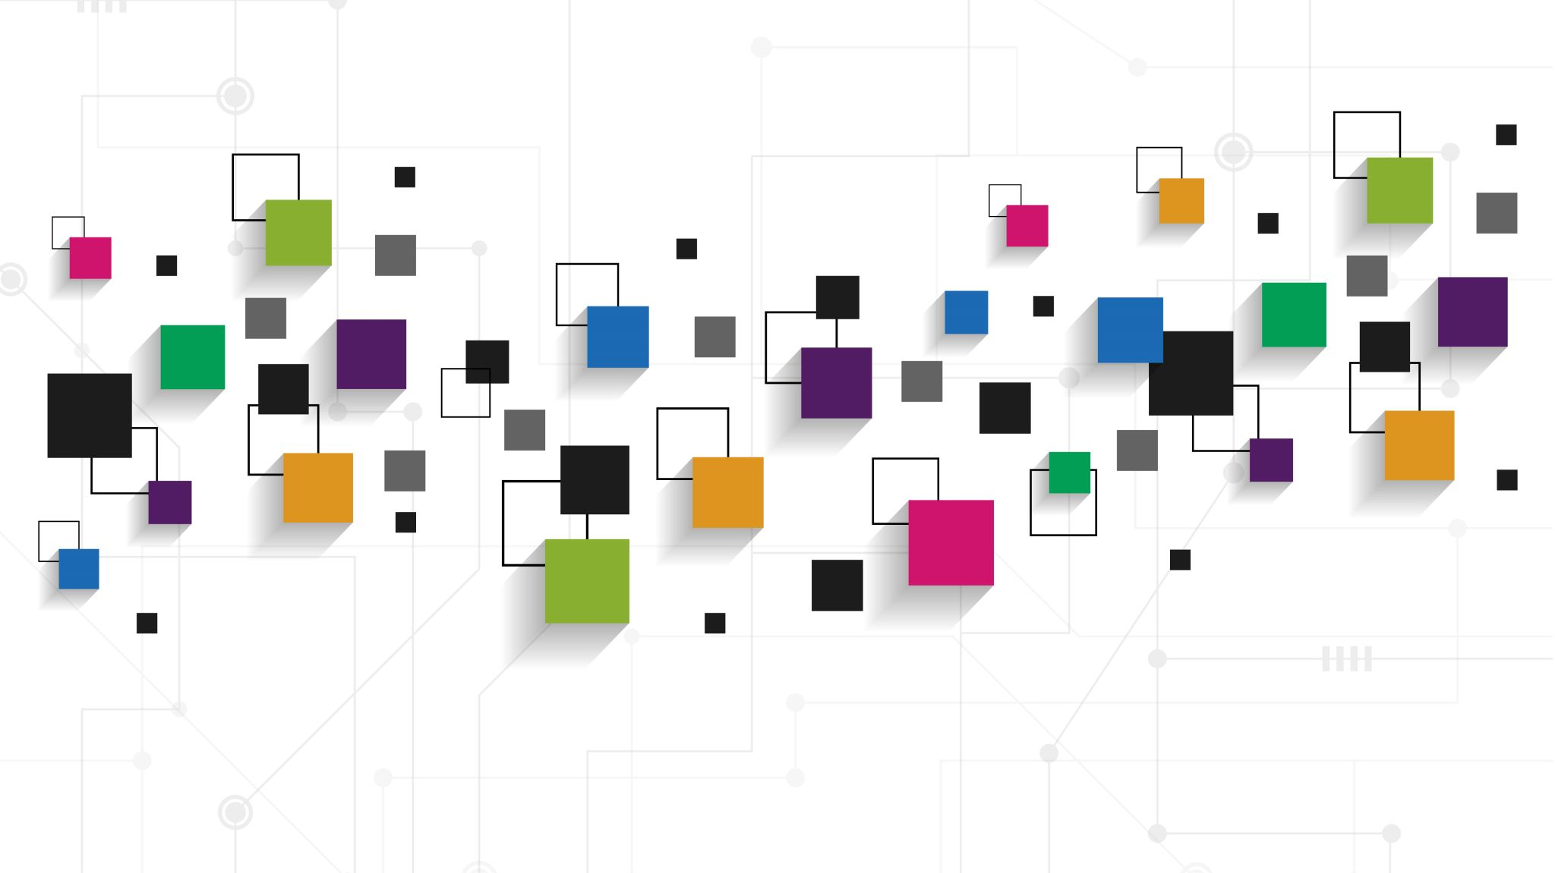
Why Deep Learning?
Deep learning is chosen for its ability to automatically learn intricate patterns from large datasets, its capability to handle diverse data types including images, text, and audio, its achievement of state-of-the-art performance in various tasks such as image recognition and natural language processing, its scalability to handle large-scale problems with advances in hardware and software frameworks, and its continual advancements driving innovation and applications across industries.

Slide 12

Dataset
- Dataset "hypothyroid disseration.csv" contains attributes including age, sex, medication status, and thyroid hormone levels.
- It offers binary classification for hypothyroid or non-hypothyroid status and presents patient-specific information.
- The dataset's variability provides valuable insights for researching hypothyroidism, aiding in predictive modeling and diagnostic tool development.

Slide 13
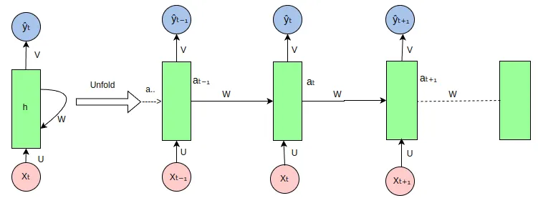
Methodology
The dataset provided contains information related to thyroid conditions, but it does not specify the RNN architecture for analysis. When choosing an RNN architecture for analyzing sequential data like this, considering the nature of the data and task complexity is crucial.
Model Architecture
Common RNN architectures suitable for this type of analysis include Long Short-Term Memory (LSTM) and Gated Recurrent Unit (GRU). LSTM is known for handling long-range dependencies well, making it suitable for sequences with long-term dependencies. On the other hand, GRU is simpler than LSTM but still effective for capturing dependencies in sequential data. Depending on the specific characteristics of the thyroid dataset and the complexity of the analysis task, either LSTM or GRU could be appropriate choices for building an RNN model

Slide 14
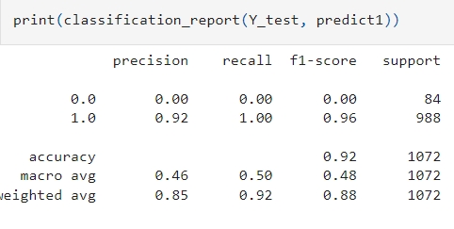
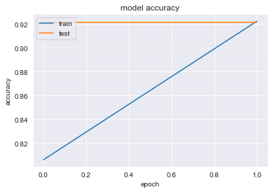
Model 1: Long Short-Term Memory
Long Short-Term Memory (LSTM) is a type of recurrent neural network (RNN) architecture that is designed to overcome the limitations of traditional RNNs in capturing and learning long-term dependencies in sequential data. It was introduced by Hochreiter and Schmidhuber in 1997.
The key advantage of LSTM networks over traditional RNNs is their ability to effectively retain and utilize information over long sequences, making them particularly well-suited for tasks involving sequential data such as speech recognition, natural language processing, time series prediction,

Slide 15
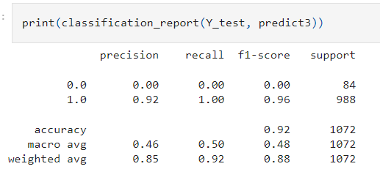
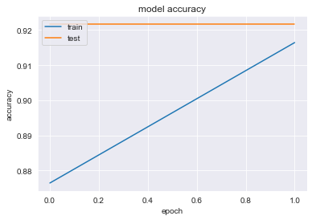
Model 2: Stacked Long Term Short Memory
Stacked Long Short-Term Memory (LSTM) is a variant of the LSTM architecture where multiple LSTM layers are stacked on top of each other. Each LSTM layer consists of multiple LSTM cells, and the output of one layer serves as the input to the next layer. Stacking LSTM layers allows for the creation of deeper neural networks, enabling the model to learn more complex hierarchical representations of the input data.
The architecture of a stacked LSTM typically follows a hierarchical structure, with each layer capturing increasingly abstract features from the input sequence. The first LSTM layer processes the raw input sequence and extracts low-level features, while subsequent layers capture higher-level representations by combining the output of the previous layer with additional context information.

Slide 16
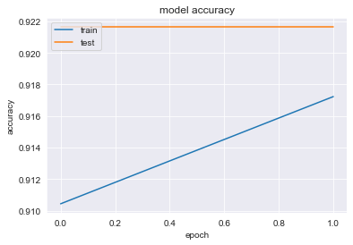
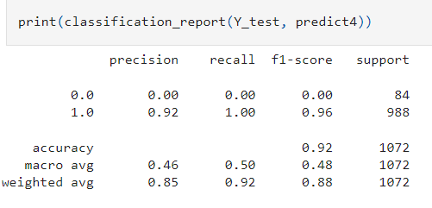
Model 3: GRU
Gated Recurrent Unit (GRU) is another type of recurrent neural network (RNN) architecture, similar to LSTM, designed to address the vanishing gradient problem in traditional RNNs and capture long-term dependencies in sequential data.
Gated Recurrent Unit (GRU) is a powerful recurrent neural network architecture that addresses the limitations of traditional RNNs while offering simplicity, efficiency, and effectiveness in capturing long-term dependencies in sequential data.

Slide 17
Results & Analysis
This project uses RNN based models such as Vanilla LSTM, Stacked LSTM, Bi-Directional LSTM and Gated Recurrent Unit(GRU). This project has an accuracy around 92%, with Vanilla LSTM having least loss.

Slide 18
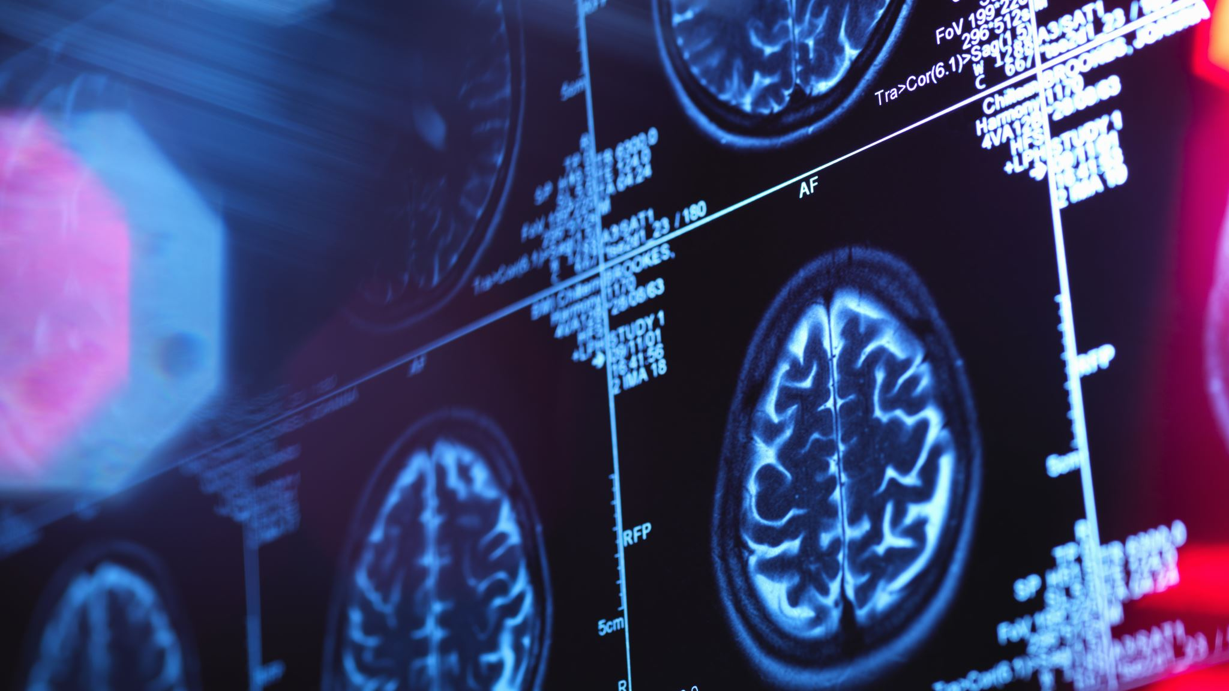
Conclusion
The project aims to revolutionize thyroid nodule detection through deep learning, with the potential to significantly impact healthcare outcomes and accessibility.
The effective deployment of RNNs highlights their capacity to enhance patient care by precisely detecting and categorising thyroid nodules using data-derived insights.
Advancing further, ongoing research and development in this domain show potential for raising diagnostic precision and consequently enhancing healthcare results for patients.

Slide 19
References:
Thyroid nodule.(2023). Retrieved from: https://en.wikipedia.org/wiki/Thyroid_nodule#:~:text=Thyroid%20nodules%20are%20nodules%20(raised,common%2C%20and%20often%20go%20unnoticed.
Han, D., Ibrahim, N., lu, F., Zhu, Y., Du, H., & Alzoubi, A. (2023, October 21). Automatic detection of thyroid nodule characteristics from ... Automatic Detection of Thyroid Nodule Characteristics From 2D Ultrasound Images.
https://journals.sagepub.com/doi/10.1177/01617346231200804
Wang, L., Yang, S., Yang, S., Zhao, C., Tian, G., Gao, Y., Chen, Y., & Lu, Y. (2019, January 8). Automatic thyroid nodule recognition and diagnosis in ultrasound imaging with the Yolov2 Neural Network - World Journal of Surgical Oncology. BioMed Central.
https://wjso.biomedcentral.com/articles/10.1186/s12957-019-1558-z
Li, T., Jiang, Z., Lu, M., Zou, S., Wu, M., Wei, T., Wang, L., Li, J., Hu, Z., Cheng, X., & Liao, J. (2020). Computer-aided diagnosis system of thyroid nodules ultrasonography: Diagnostic performance difference between computer-aided diagnosis and 111 radiologists. Medicine, 99(23), e20634.
https://doi.org/10.1097/MD.0000000000020634

Slide 20
Thank you

